Slide 1

Department of Information Technology
A.P. Shah Institute of Technology
G.B.Road,Kasarvadavli, Thane(W), Mumbai-400615
UNIVERSITY OF MUMBAI
Academic Year 2019-2020

Slide 2
A Project Report on
IT ENABLED FOOD BANK
Submitted in partial fulfillment of the degree of
Bachelor of Engineering(Sem-7)
in
INFORMATION TECHNOLOGY
By
Sagar Randive(16204001)
Shanakar Pednekar(16204027)
Vimal Sharma(15104044)
Under the Guidance of
Name of Guide: Ganesh Gourshete

Slide 3
1.1 Abstract
This project is used to manage wastage foods in a useful way. Every day the people are wasting lots of foods. So we have to reduce that food wastage problem through online. If anyone have wastage foods they are entering their food quantity details and their address in that application and then the admin maintain the details of food donator.
The donator can create the account and whenever they are having wastage food they can login and give request to the admin. And the admin also maintain the buyer(orphanage,poor people,..) details too. After the admin view the donator request and give the alert message like time to come and collect the food.

Slide 4
1.2 Problem Definition
Food wastage is a massive problem and one of the most overlooked thing in today’s world
One third of all food produced in the world goes to waste
Some restaurants/cafés have a policy to not serve food from previous day, despite being perfectly edible. This is all thrown away as “waste”, at the end of day.
Roughly $400B in food ends up in landfills every year resulting in 3.3 billion metric tons of greenhouse gases annually which has multiple effects on the world. (ref: http://foodtechconnect.com/2015/10/09/10-startups-reducing-food-waste-one-byte-at-a-time/
At the same time, worldwide nearly 800 million people do not have enough to eat. That means one in nine people are suffering from hunger.

Slide 5
WHY WE NEED?
Currently, One third of the world food supply ends up in the trash.
Food waste is serious Ecological Hazards, Responsible for 8% of Green House Gas
Emission. One-Fourth of our Fresh water Usage.
Wasting food means wasting money, Labours and Resources such as Energy land and water that go in producing food.
Wasting food increase greenhouse emission and climate change.
Climate change

Slide 6
WHAT WE NEED ?
Recycle by Composting: Food producers can solve 100% of their food waste problems by simply organizing an effective composting strategy. And doing so not only eliminates waste, it also saves you money because you don’t need to “outsource” your compost production.
Turn Wasted Food into Animal Feed: Cultivating compost is one way to recycle food, but it can also be done in the bellies of cattle, sheep, pigs, and other livestock (themselves destined to become food).
Use Waste Food to Produce Products: From bio-fuels to liquid fertilizer, there are many useful products that can be manufactured from certain kinds of waste foods. And often “left overs” of one company could be useful in another industry for the food scrap.
Source Reduction: The simplest way to curtail food waste is to simply produce less whenever overproduction is clearly leading to waste.
Food Donation: When excess foodstuffs are still safe to eat, they can be given to the hungry and the poor who find it difficult to afford sufficient food in today’s high-priced economy.

Slide 7
1.3 Proposed system
In proposed system we are reduce that food wastage using that
This project is food redistribution is an enormously successful social
innovation that tackles food waste and food poverty.
the admin collect foods from donator through their nearby agent then provide to nearest orphanages(ngo) or poor people.
After receiving the food from the agent by admin and give alert message to that donator through this way we can reduce food wastage problem.

Slide 8
1.6 Technology stack
Software requirements:
Operating System :Windows
Technology : PHP
Web Technologies : Html, JavaScript, CSS
IDE : Notepad++
Web Server : Wamp2.2e
Database : My SQL
Hardware Requirements:
Hardware - Pentium
Speed - 1.1 GHz
RAM - 1GB
Hard Disk - 20 GB
Floppy Drive - 1.44 MB
Key Board - Standard Windows Keyboard
Mouse - Two or Three Button Mouse
Display/Monitor - SVGA

Slide 9
USE CASE:
Use Case 1 : Collection Request
A restaurant/café worker creates a collection request for excess food, which is then sent across to all the NGOs within the network.
An NGO manager can view all the request raised by restaurants for pick-up and assign it to an employee in their enterprise, who will then proceed with the collection of the delivery and updating the inventory .
If the NGO manager feels they have sufficient food in the inventory and sees a shortage request from other NGO, they can directly assign it to the NGO for further processing.
After either of the 2 cases, the request is then forwarded to logistics manager’s queue
Any logistics manager can pickup the request and assign it to one of their employee

Slide 10
Use Case 2 : Invoice Request After a successful delivery, a delivery cost is provided against it. A Logistics manager can then generate an invoice for all successful deliveries made by their enterprise, to a particular NGO This request is then forwarded to the respective NGO’s manager who would then be responsible for the payment of the same

Slide 11
Use Case 3 : Shortage Request
An NGO manager while viewing the enterprises’ inventory can raise a shortage request
The manager also mentions an employee who would then follow-up on the request
This request is then forwarded to all other NGO managers within the network
An NGO manager can then redirect a particular collection request to an NGO facing a shortage
The logistics and collection then proceeds like a usual collection request
This collection request is linked to the original shortage request

Slide 12
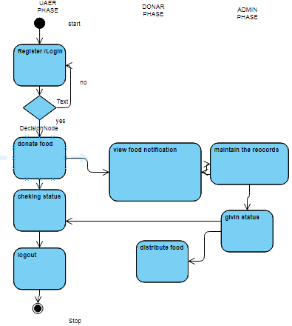
Activity digram

Slide 13
Class Diagram

Slide 14
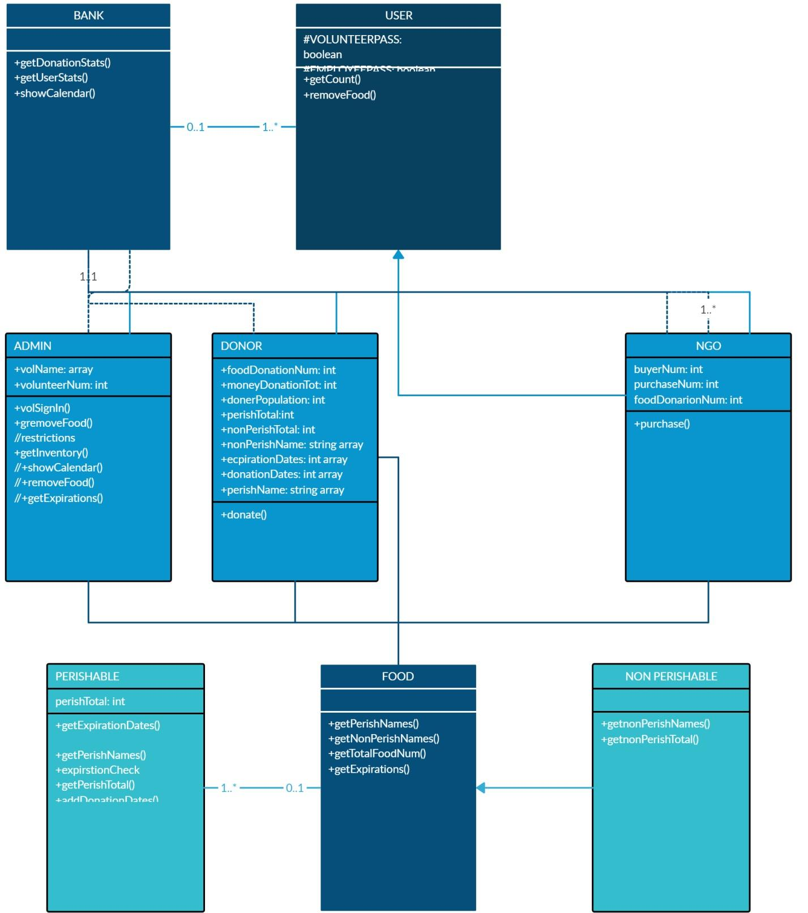

Slide 15
Use Case 4 : Food distribution
Any NGO employee(worker) can distribute food to people from the collection.
The employee can view the inventory, as well as the time before which the particular food item would perish
This way, maximum wastage can be avoided
The number of people fed are then updated after a particular distribution

Slide 16
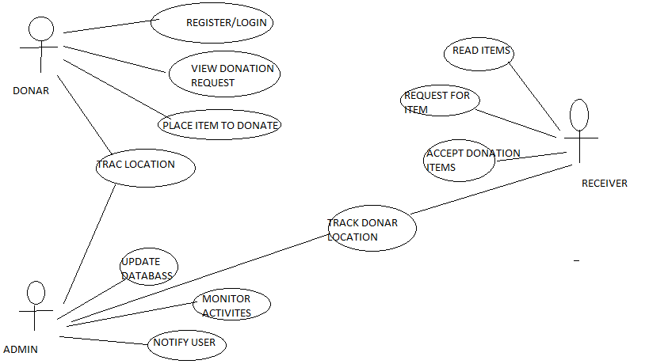
Use Case Diagram

Slide 17
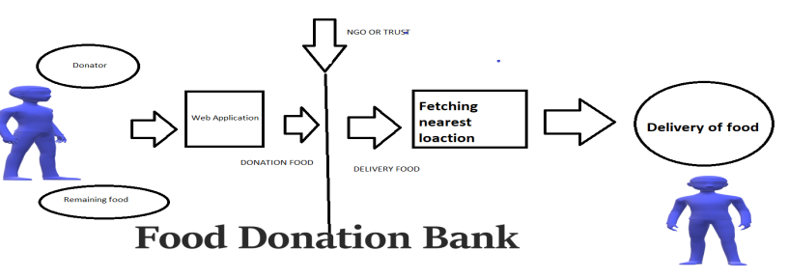
Data flow daigram

Slide 18
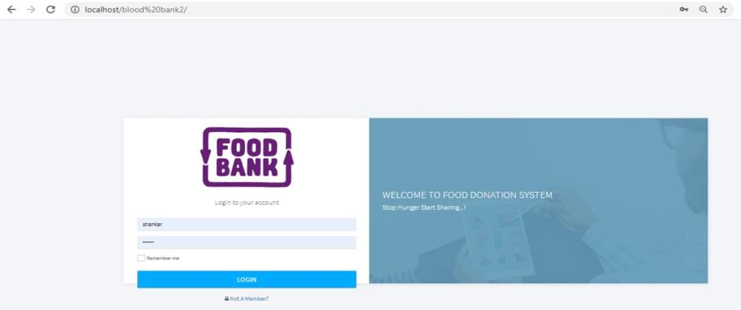
HOME PAGE:

Slide 19
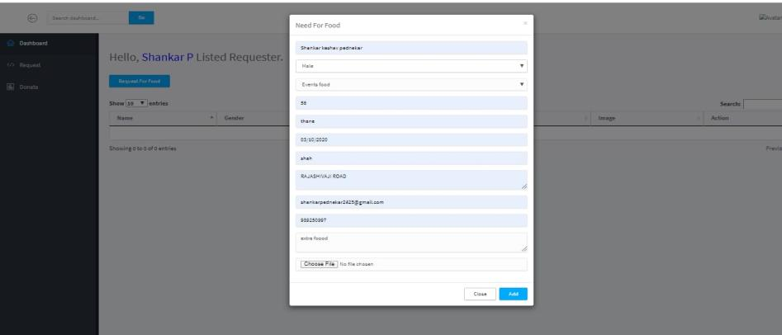
DONER PAGE:

Slide 20
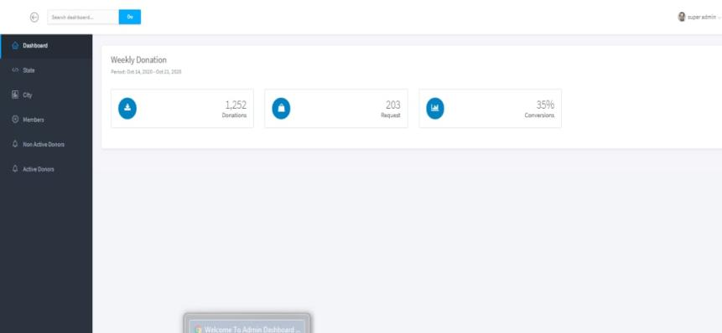
NGO MODULE:

Slide 21
3.Future Scope
Donations of food by small quantity to the man to hungry peoples.
Finding nearest donation food places for beggars to temple,NGO etc helps.

Slide 22
Thank You

